Slide 1
Global Sales Dashboard
GUVI HCL Project
Submitted by: Abhishek Karn Email: abhishek_2312res16@iitp.ac.in

Slide 2
Description
This project, titled Global Sales Performance Dashboard, is built to analyze the sales performance of a retail store that operates globally across various countries and continents. Using Tableau, the dashboard visually presents key insights by combining map charts, line graphs, bar charts, and KPI cards. It tracks how sales and profits vary over time, across different product categories, and across geographical regions. The dashboard allows users to interact using filters for year, region, and product category to explore specific areas of interest. This helps in identifying top-performing regions, analyzing category-wise contributions, and understanding sales trends ultimately supporting data-driven business decisions for a worldwide retail operation.

Slide 3
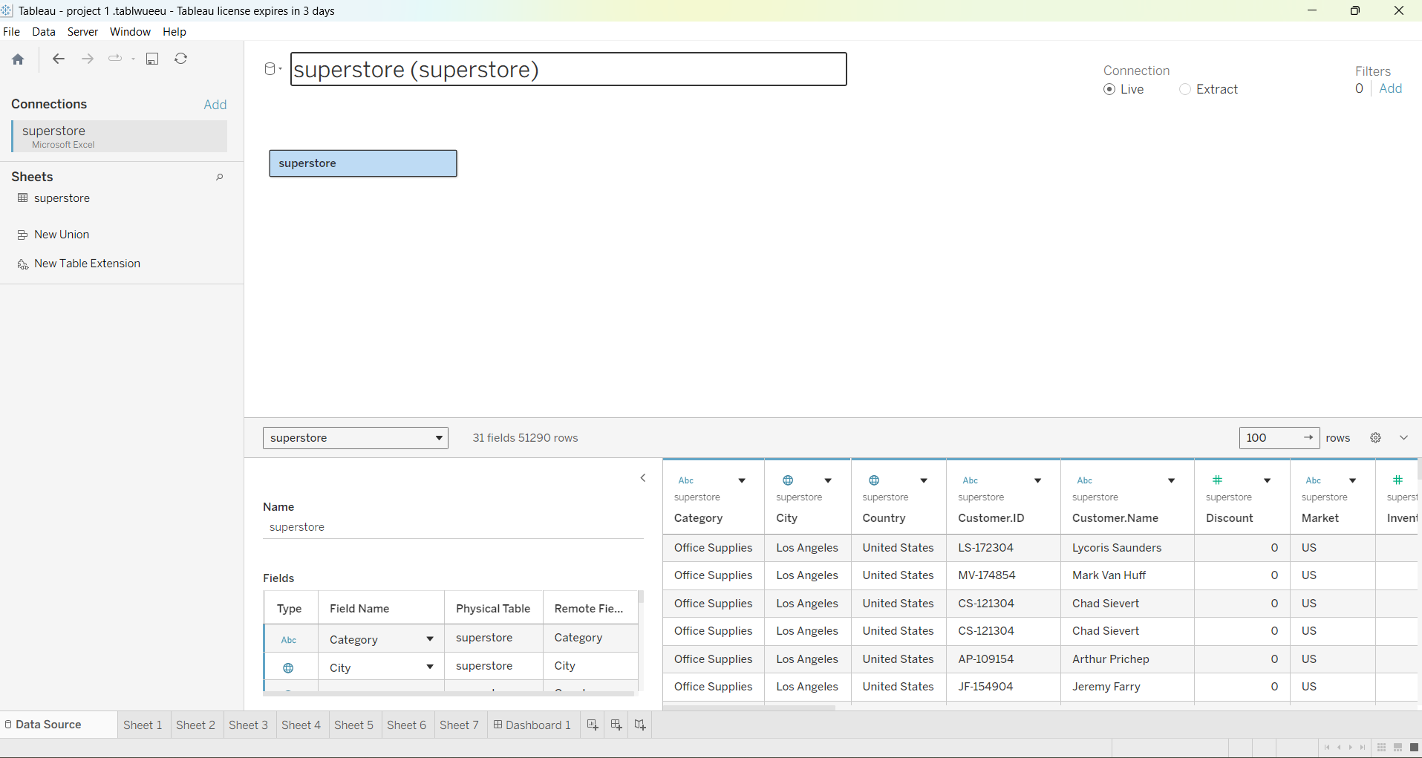
Importing Dataset
I connected Tableau to the dataset provided in Excel format.

Slide 4
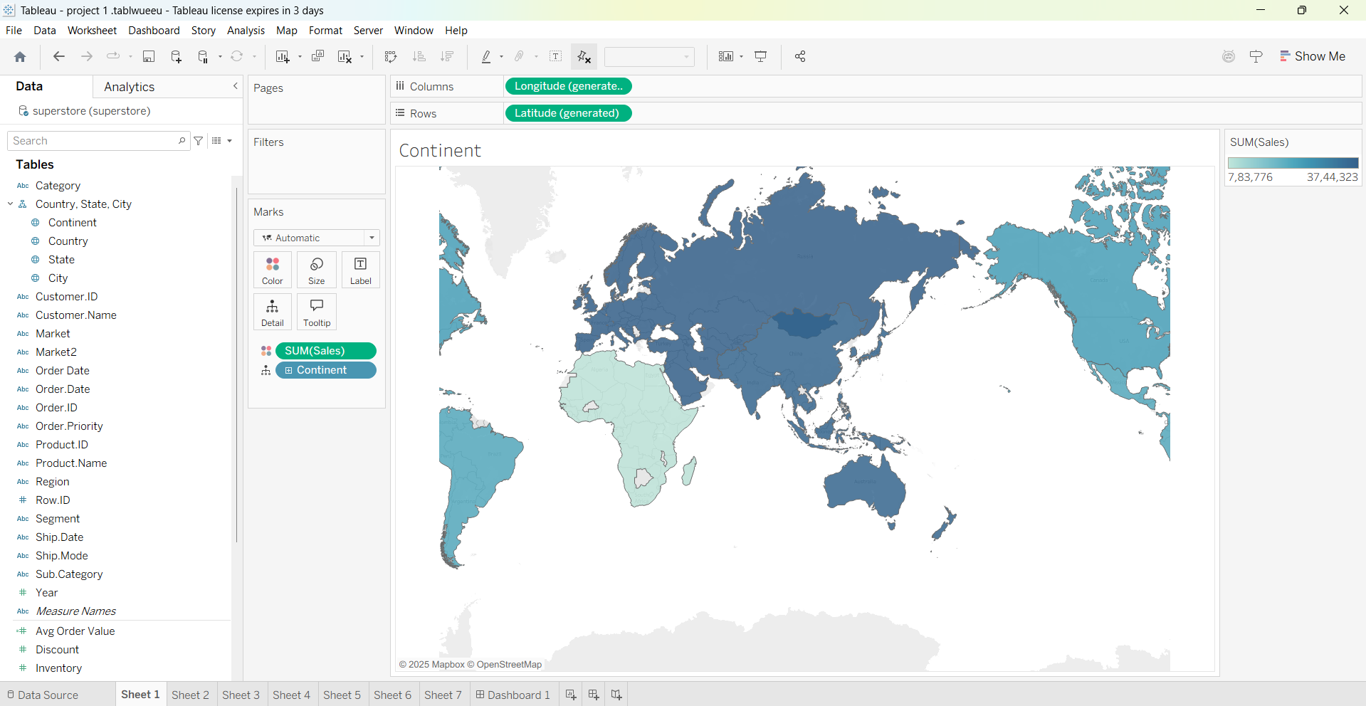
Map Chart
This map chart visualizes the variation in sales across different continents. It helps identify regions with the highest and lowest sales performance.

Slide 5
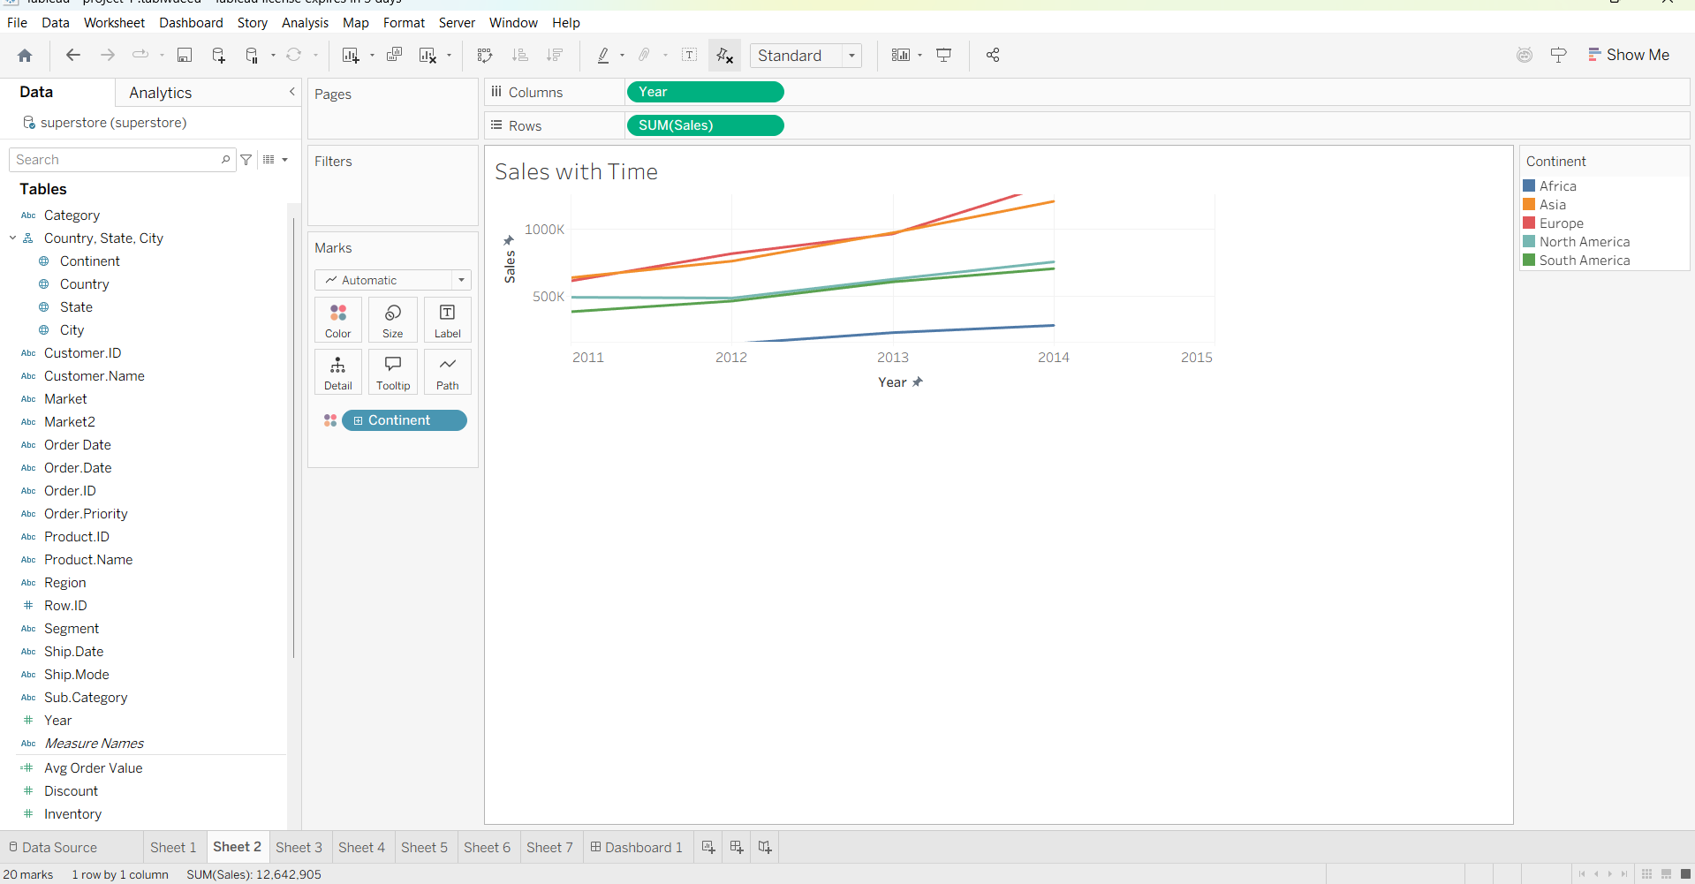
Line Charts
This line chart visualizes sales trends over time across different countries. It helps track growth and compare performance regionally.

Slide 6
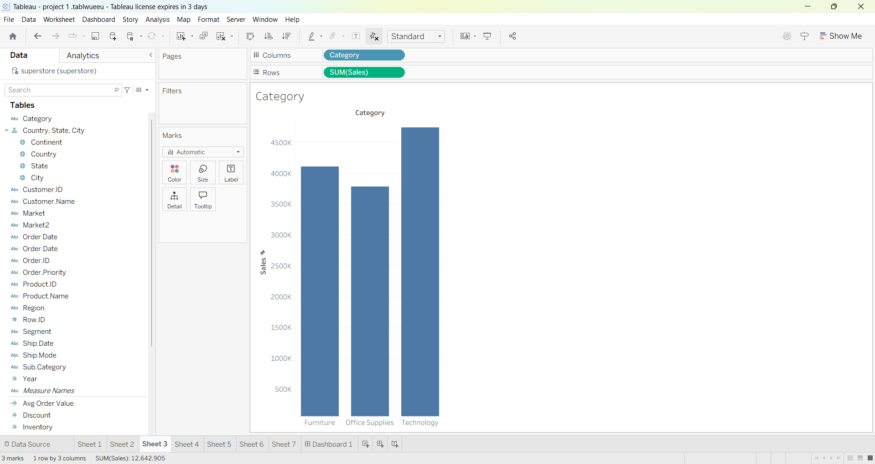
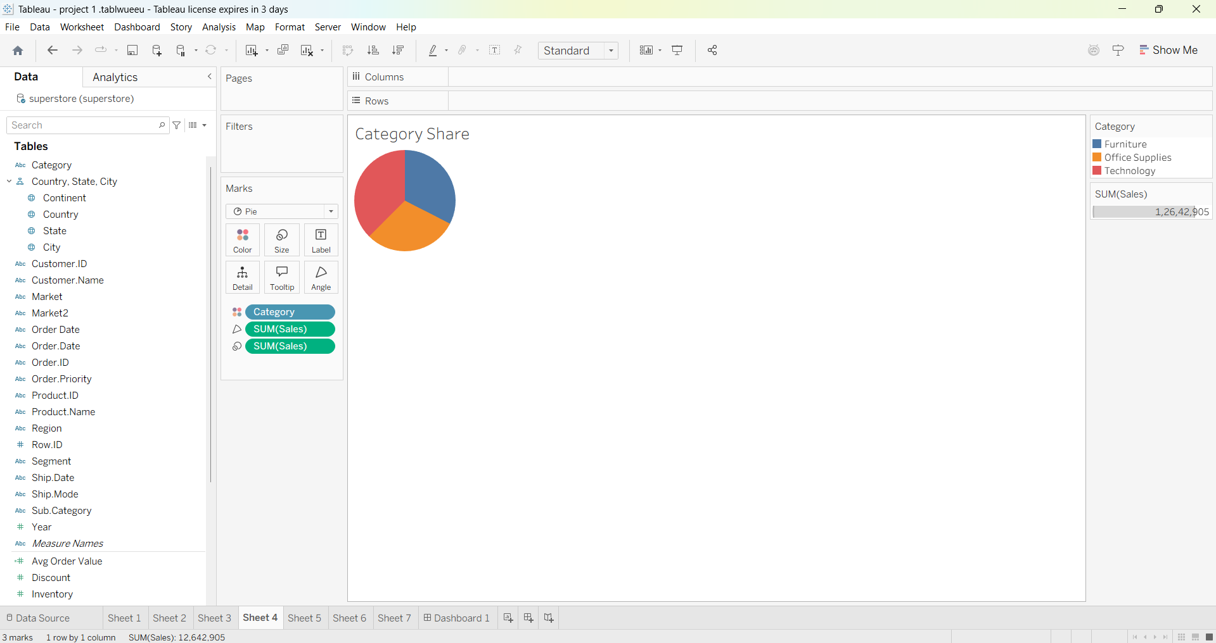
Category Wise Distribution
"These visualizations help us understand the distribution of sales across different product categories. They highlight which categories contribute most to overall sales.

Slide 7
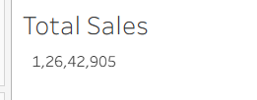
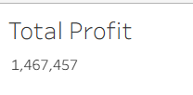

Adding KPI's
The KPI card provides a clear numerical representation of key performance metrics such as total sales or profit. It offers a quick and concise summary to support data-driven decision-making

Slide 8
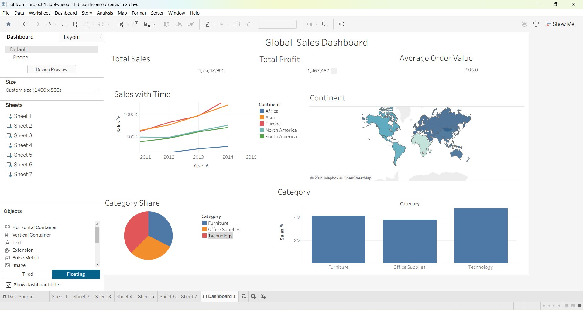
Formatting Worksheets
Formatting is one of the most important aspects of reporting, as it enhances clarity, readability, and the overall visual appeal of the dashboard.

Slide 9
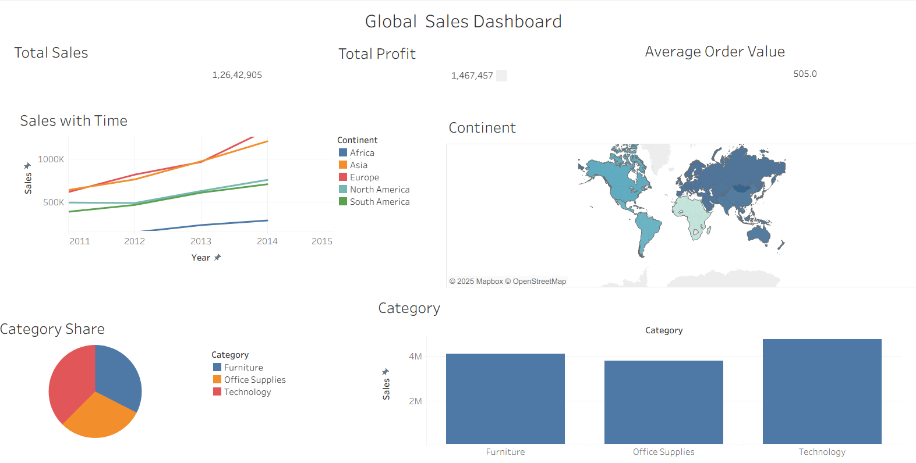
Dashboard

